Slide 1
Formal Verification of RL-based Approaches

Slide 2
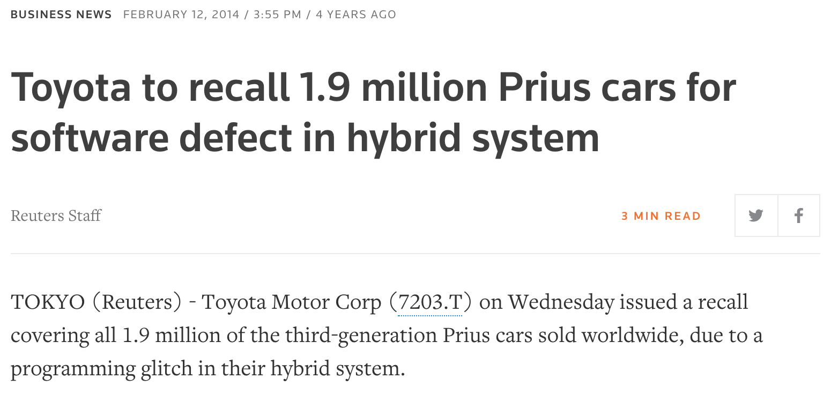
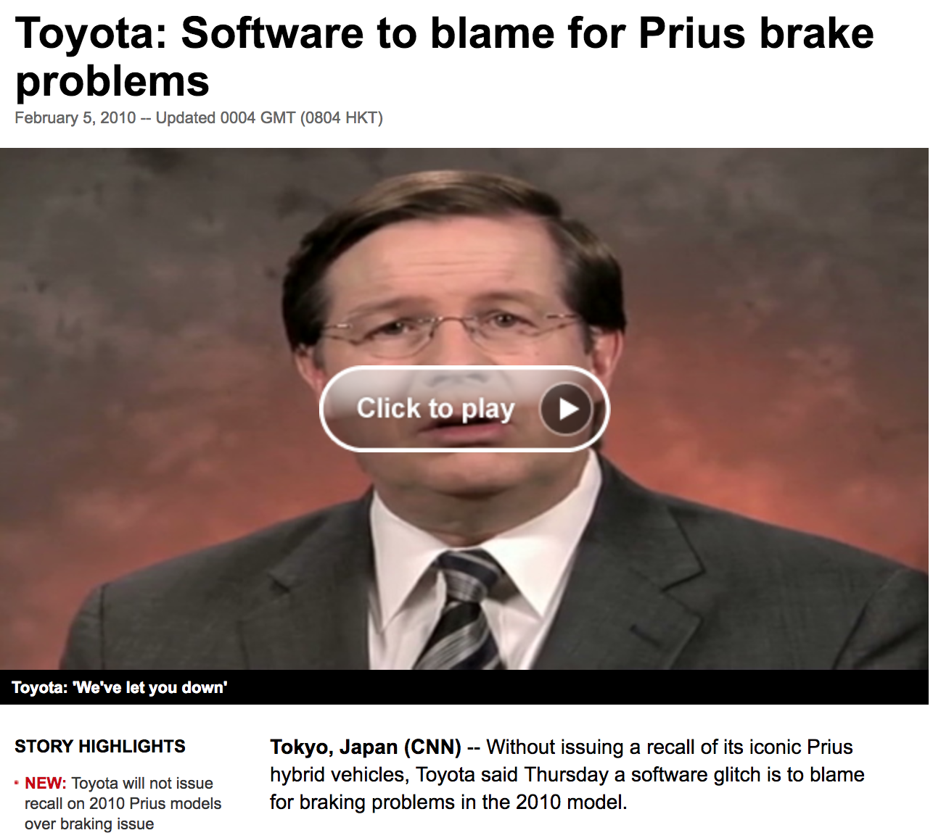
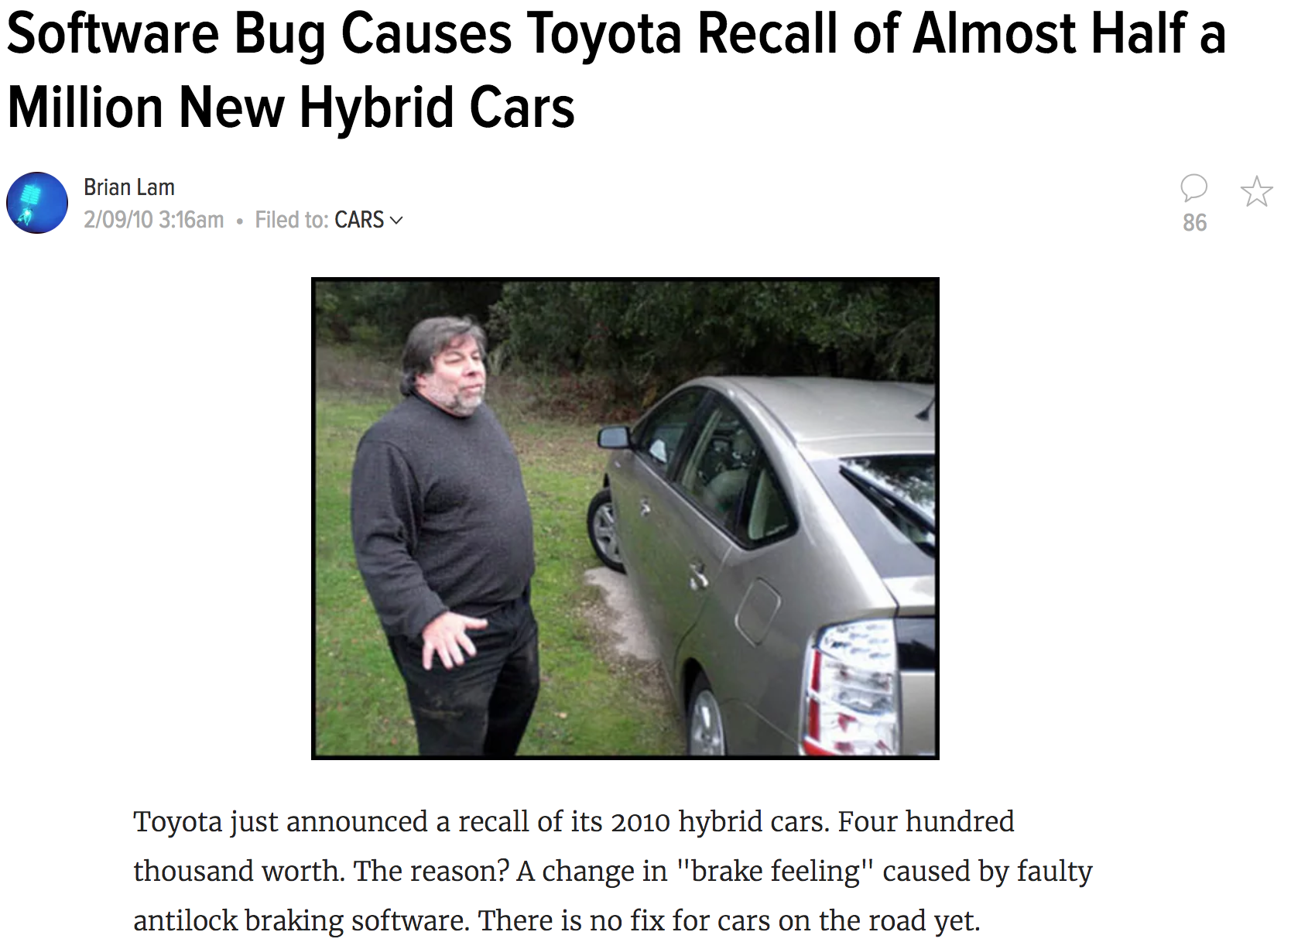

Slide 3
Testing does not suffice
“Program testing can be a very effective way to show the presence of bugs, but is hopelessly inadequate for showing their absence.“
Edsger W. Dijkstra

Slide 4
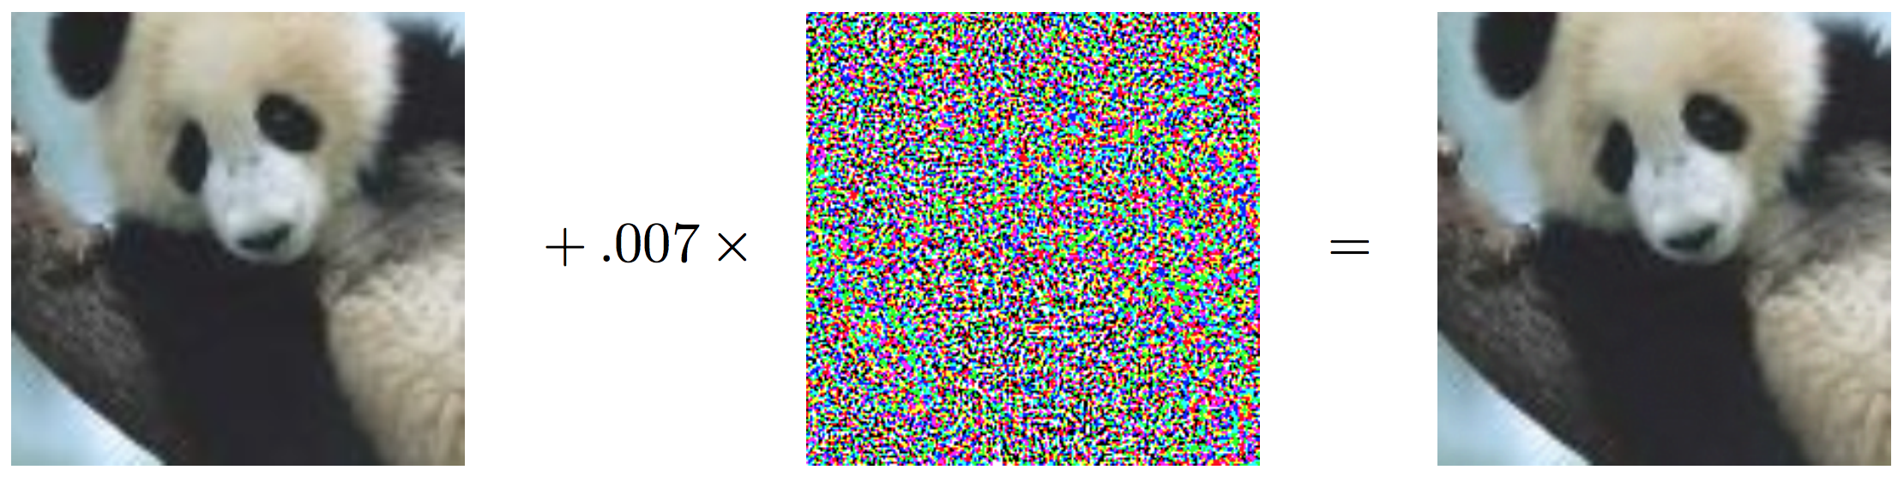
Adversarial Examples
“panda” 57.7% confidence
“gibbon” 99.3% confidence
Notes:
https://arxiv.org/pdf/1412.6572.pdf (2015)

Slide 5
Adversarial Examples

Slide 6
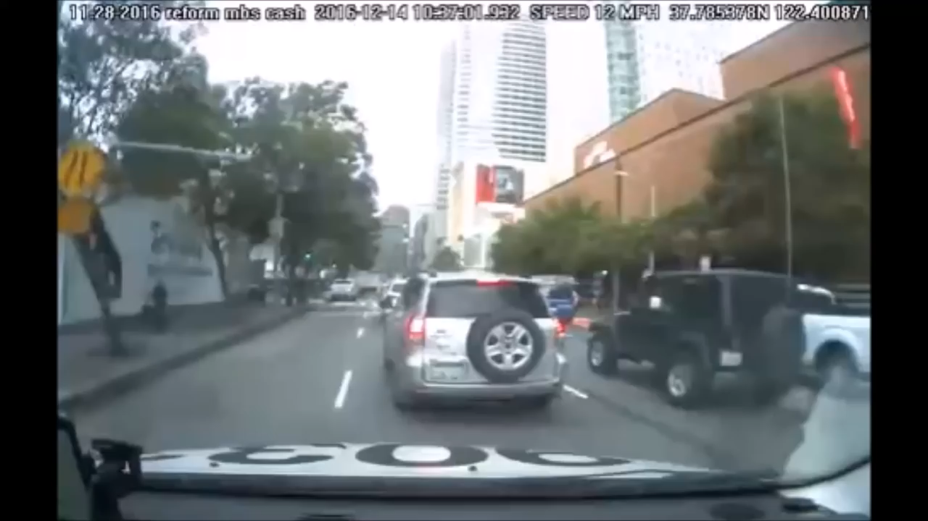
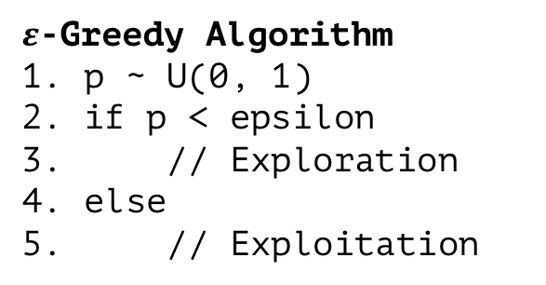
Safe Learning!
$ε$-Greedy Algorithm
1. p ~ U(0, 1)
2. if p < epsilon
3. // Exploration
4. else
5. // Exploitation
usually random action,
but this might damage
someone!

Slide 7
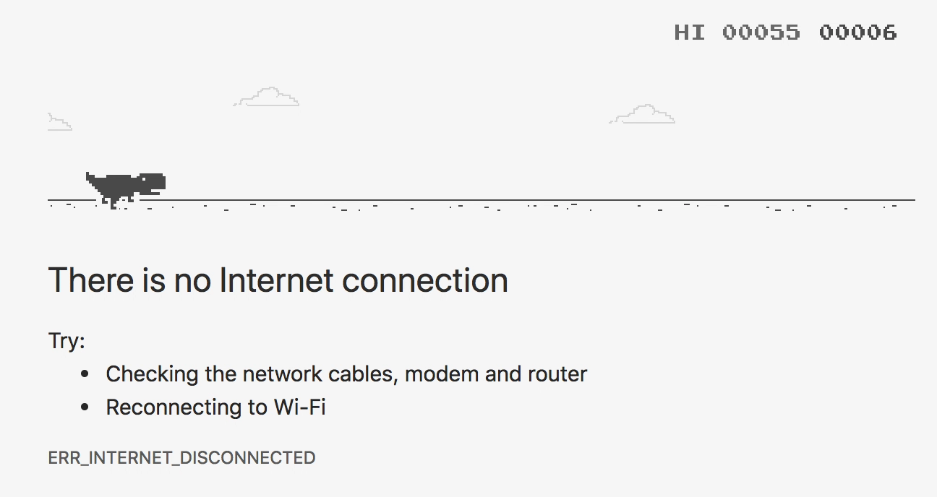
Accelerate Learning!

Slide 8
Optimization vs Safety
Clever RL Algorithm
Problem
Optimized Policy
+
Theorem Solver
Specification
Safe Policy
Optimized and Safe Policy?

Slide 9
//Why Formal Verification?
Safety
Ensure that learning does not cause harm
esting does not suffice → Safety
Bugs can be prevented
Ensure that a (learned) policy ”works”
Already standard in many areas! (aviation)
ISO 26262
Faster learning:
During learning, unsafe policies are explored
poor initial performance → faster learning
Exploit domain knowledge
Cost Reduction
Find out about bugs early and be in a better position to fix them
Organizational matters
Certification processes
ISO 26262

Slide 10
Research Questions
Does Formal Verification make autonomous driving 100% safe?
How can we deal with uncertain situations?
How can we ensure that the model will always act in a safe way?

Slide 11
//Topics
Our Introduction
Why Formal Verification, Problems in RL, Motivation, Our Research Questions
Formal Verification in RL Simple Verification Example
Validation vs. Verification
Assumptions (Environment, Platform, Data, Algorithm)
Properties that can be verified (MDP, State to Action, …)
Methods
Verification of an MDP: Model Checking Action to Action Sequences: PRISM State to Action: Neural Networks (Reluplex)
Runtime Verification: JSCGeneric
(Verification of an Algorithm: SafeLyapunovLearning)
Problems and Open Question
Short summary, opinion, …
Notes:
Methoden:
Model verifiieren
NN
Online ..

Slide 12
Topics
Introduction to Formal Verification
Assumptions in Machine Learning Algorithms
Verifiable Properties and Methods in RL
Problems and Open Questions

Slide 13
What can be verified?
Offline: validate after learning
State to Action: Verify that a certain action will not happen in a given state
Action sequences (via PRISM)
Algorithm properties (e.g. convergence to a fix point)
Assumptions on Training Data (variable ranges, …)
Online: validate during learning
State to Action
Action sequences
Monitoring

Slide 14

State to Action Verification

Slide 15
State to Action Verification
verify that network still chooses the right action
even if sensor data is corrupt

Slide 16
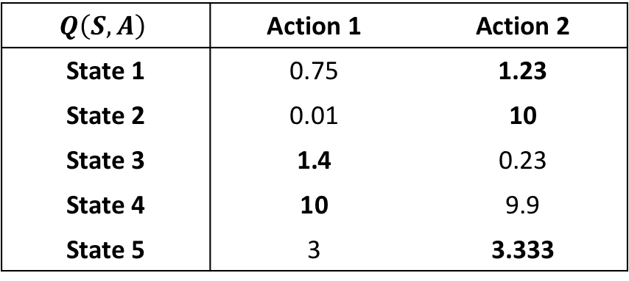
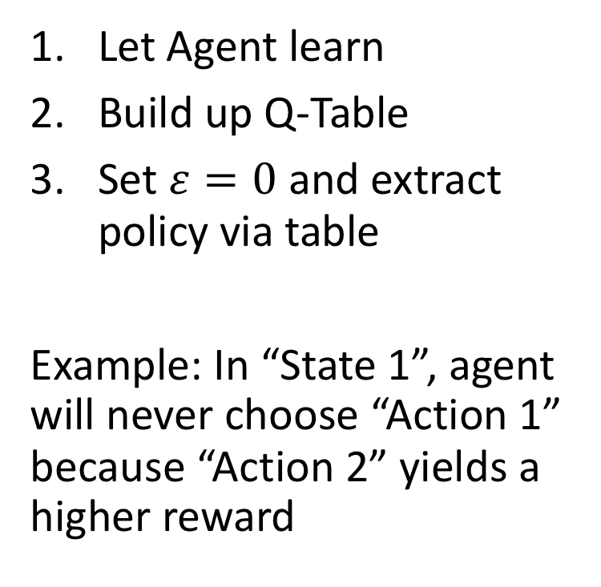
State to Action Verification in Q-Learning
$$Q\left(S, A\right)$$ | Action 1 | Action 2
State 1 | 0.75 | 1.23
State 2 | 0.01 | 10
State 3 | 1.4 | 0.23
State 4 | 10 | 9.9
State 5 | 3 | 3.333
Let Agent learn
Build up Q-Table
Set $ε=0$ and extract policy via table
Example: In “State 1”, agent will never choose “Action 1” because “Action 2” yields a higher reward
large / continuous

Slide 17
Function Approximation
non-linear
$$Q\left(S, A\right)$$ | Action 1 | Action 2
State 1 | 0.75 | 1.23
State 2 | 0.01 | 10
State 3 | 1.4 | 0.23
State 4 | 10 | 9.9
State 5 | 3 | 3.333
typically large

Slide 18
≥95% “panda”

Slide 19
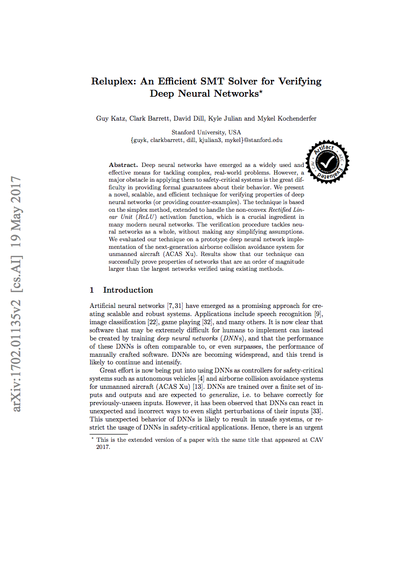
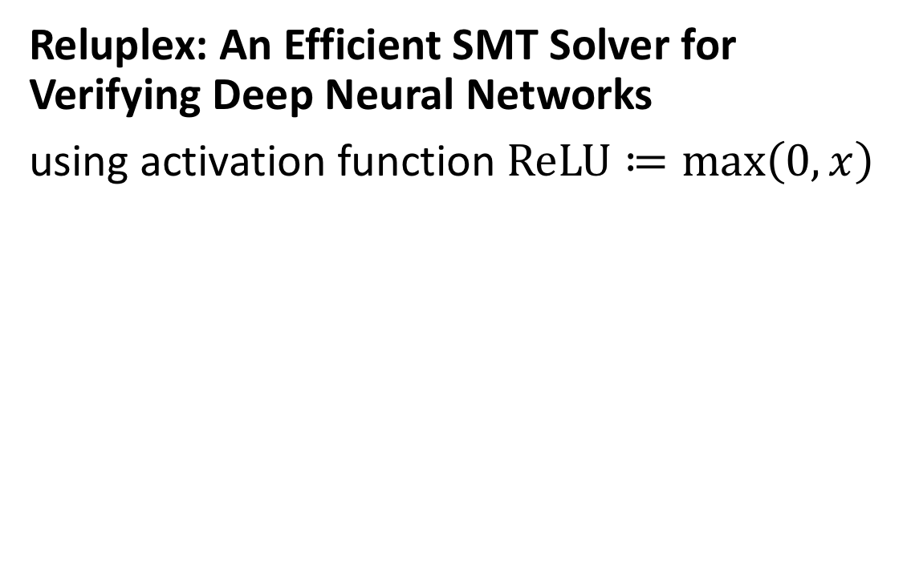
Reluplex: An Efficient SMT Solver for Verifying Deep Neural Networks
using activation function $ReLU≔\max\left(0,x\right)$
This makes it hard to verify

Slide 20
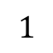
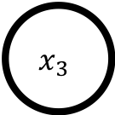
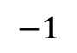
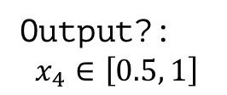

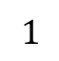
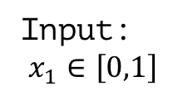
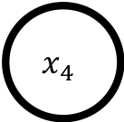
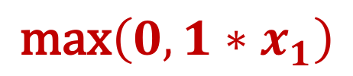
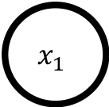
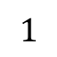
Simple Neural Network
$$\text{max}\left(0,1∗x_{1}\right)$$
$$x_{2}$$
$$1$$
$$1$$
Input:
$$x_{1}∈\left[0,1\right]$$
$$x_{1}$$
$$x_{4}$$
Output?:
$$x_{4}∈\left[0.5, 1\right]$$
$$−1$$
$$x_{3}$$
$$1$$

Slide 21
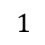

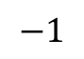
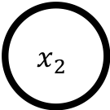
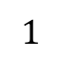
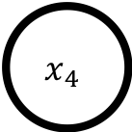

Simple Neural Network
$$x_{2}$$
$$1$$
$$1$$
$$x_{1}$$
$$x_{4}$$
$$−1$$
$$x_{3}$$
$$1$$

Slide 23
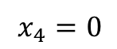
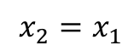
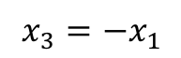
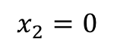
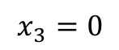
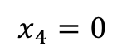
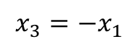
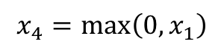
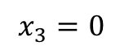
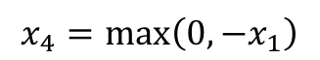
Case Splitting to make it linear
$$x_{2}=0$$
$$x_{2}=x_{1}$$
$$x_{3}=0$$
$$x_{3}=−x_{1}$$
$$x_{3}=0$$
$$x_{3}=−x_{1}$$
$$x_{4}=0$$
$$x_{4}=\text{max}\left(0, −x_{1}\right)$$
$$x_{4}=\max\left(0, x_{1}\right)$$
$$x_{4}=0$$

Slide 24
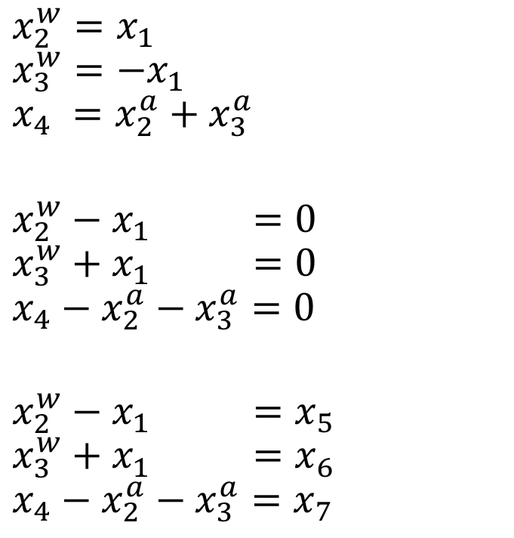
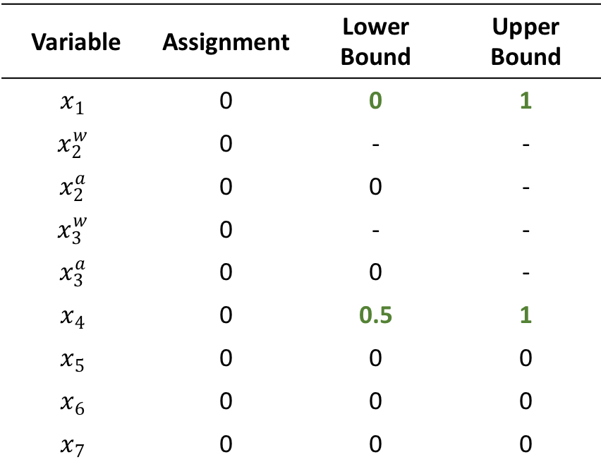
Example
Variable | Assignment | Lower Bound | Upper Bound
$$x_{1}$$ | 0 | 0 | 1
$$x_{2}^{w}$$ | 0 | - | -
$$x_{2}^{a}$$ | 0 | 0 | -
$$x_{3}^{w}$$ | 0 | - | -
$$x_{3}^{a}$$ | 0 | 0 | -
$$x_{4}$$ | 0 | 0.5 | 1
$$x_{5}$$ | 0 | 0 | 0
$$x_{6}$$ | 0 | 0 | 0
$$x_{7}$$ | 0 | 0 | 0
$$x_{2}^{w}=x_{1}$$
$$x_{3}^{w}=−x_{1}$$
$$x_{4} =x_{2}^{a}+x_{3}^{a}$$
$$x_{2}^{w}−x_{1} =0$$
$$x_{3}^{w}+x_{1} =0$$
$$x_{4}−x_{2}^{a}−x_{3}^{a}=0$$
$$x_{2}^{w}−x_{1} =x_{5}$$
$$x_{3}^{w}+x_{1} =x_{6}$$
$$x_{4}−x_{2}^{a}−x_{3}^{a}=x_{7}$$

Slide 25
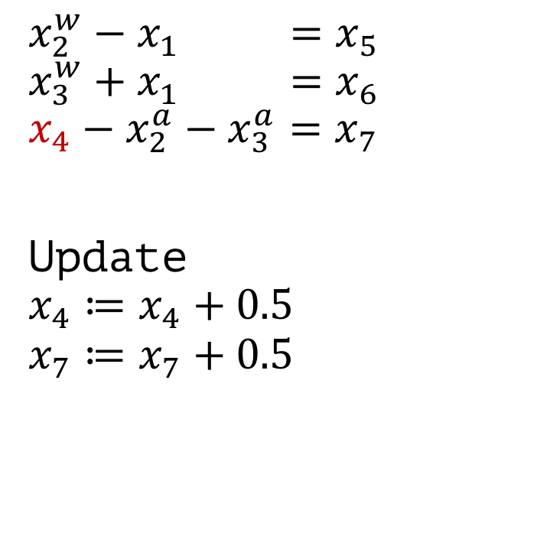
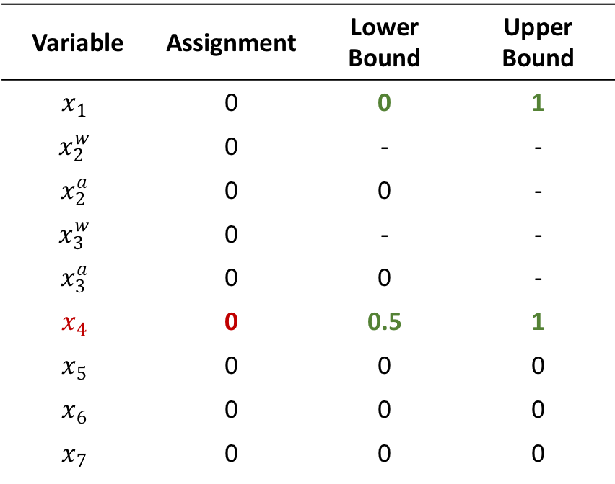
Example
Variable | Assignment | Lower Bound | Upper Bound
$$x_{1}$$ | 0 | 0 | 1
$$x_{2}^{w}$$ | 0 | - | -
$$x_{2}^{a}$$ | 0 | 0 | -
$$x_{3}^{w}$$ | 0 | - | -
$$x_{3}^{a}$$ | 0 | 0 | -
$$x_{4}$$ | 0 | 0.5 | 1
$$x_{5}$$ | 0 | 0 | 0
$$x_{6}$$ | 0 | 0 | 0
$$x_{7}$$ | 0 | 0 | 0
$$x_{2}^{w}−x_{1} =x_{5}$$
$$x_{3}^{w}+x_{1} =x_{6}$$
$$x_{4}−x_{2}^{a}−x_{3}^{a}=x_{7}$$
Update $$x_{4}≔x_{4}+0.5$$
$$x_{7}≔x_{7}+0.5$$

Slide 26
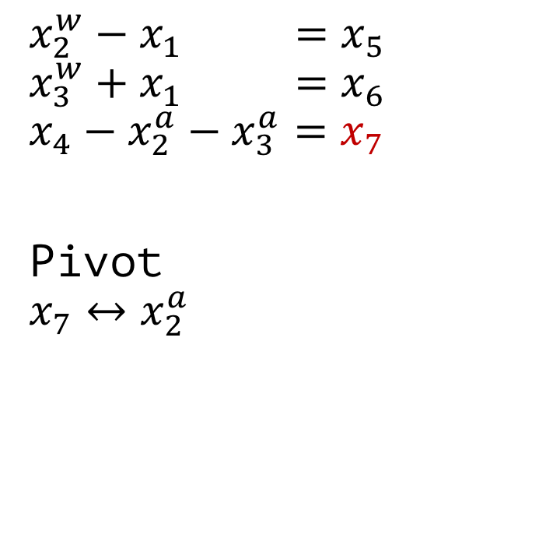
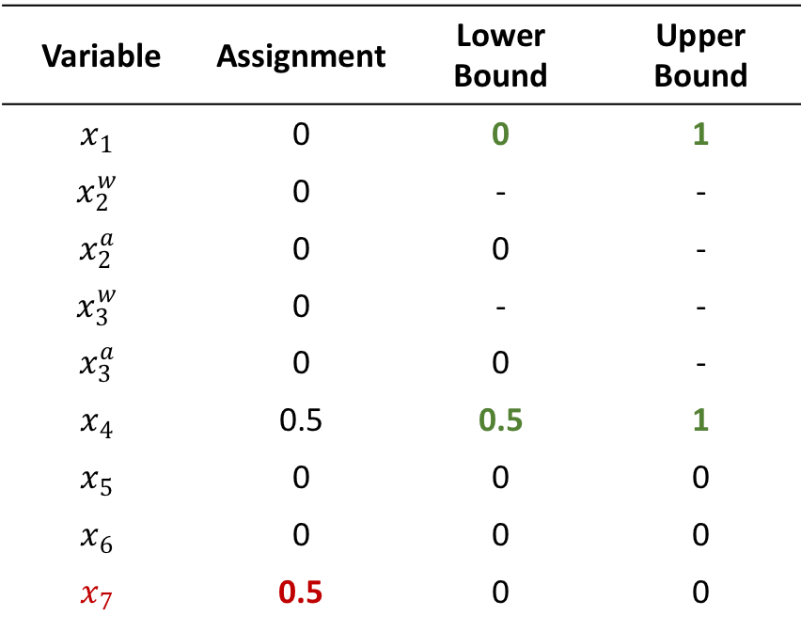
Example
Variable | Assignment | Lower Bound | Upper Bound
$$x_{1}$$ | 0 | 0 | 1
$$x_{2}^{w}$$ | 0 | - | -
$$x_{2}^{a}$$ | 0 | 0 | -
$$x_{3}^{w}$$ | 0 | - | -
$$x_{3}^{a}$$ | 0 | 0 | -
$$x_{4}$$ | 0.5 | 0.5 | 1
$$x_{5}$$ | 0 | 0 | 0
$$x_{6}$$ | 0 | 0 | 0
$$x_{7}$$ | 0.5 | 0 | 0
$$x_{2}^{w}−x_{1} =x_{5}$$
$$x_{3}^{w}+x_{1} =x_{6}$$
$$x_{4}−x_{2}^{a}−x_{3}^{a}=x_{7}$$
Pivot $$x_{7}↔x_{2}^{a}$$

Slide 27
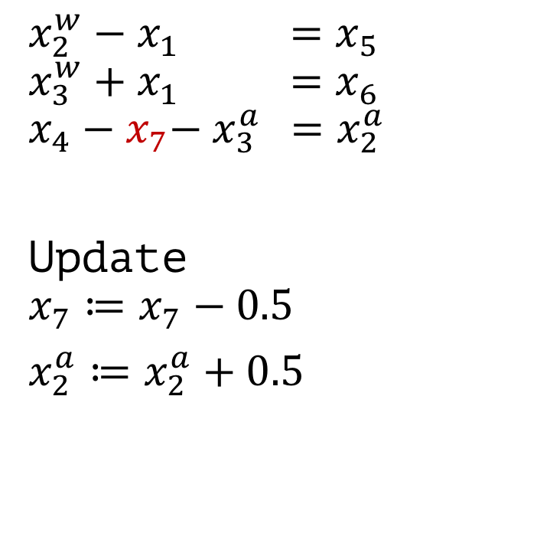
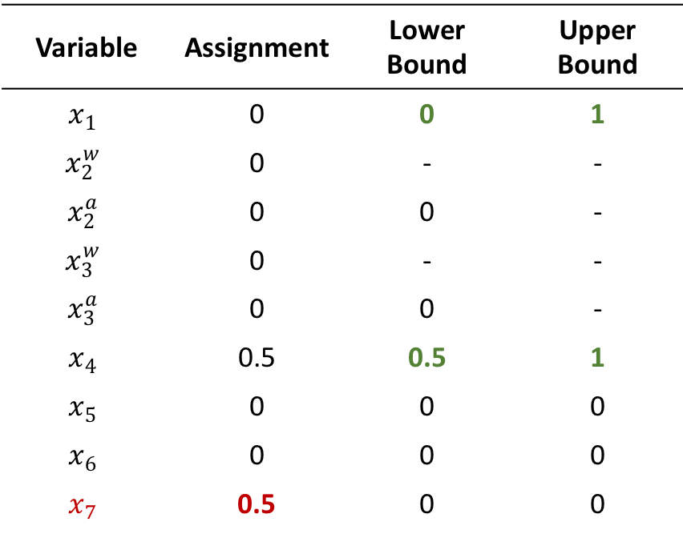
Example
Variable | Assignment | Lower Bound | Upper Bound
$$x_{1}$$ | 0 | 0 | 1
$$x_{2}^{w}$$ | 0 | - | -
$$x_{2}^{a}$$ | 0 | 0 | -
$$x_{3}^{w}$$ | 0 | - | -
$$x_{3}^{a}$$ | 0 | 0 | -
$$x_{4}$$ | 0.5 | 0.5 | 1
$$x_{5}$$ | 0 | 0 | 0
$$x_{6}$$ | 0 | 0 | 0
$$x_{7}$$ | 0.5 | 0 | 0
$$x_{2}^{w}−x_{1} =x_{5}$$
$$x_{3}^{w}+x_{1} =x_{6}$$
$$x_{4}−x_{7}−{ x}_{3}^{a} =x_{2}^{a}$$
Update $$x_{7}≔x_{7}−0.5$$
$x_{2}^{a}≔x_{2}^{a}+0.5$

Slide 28
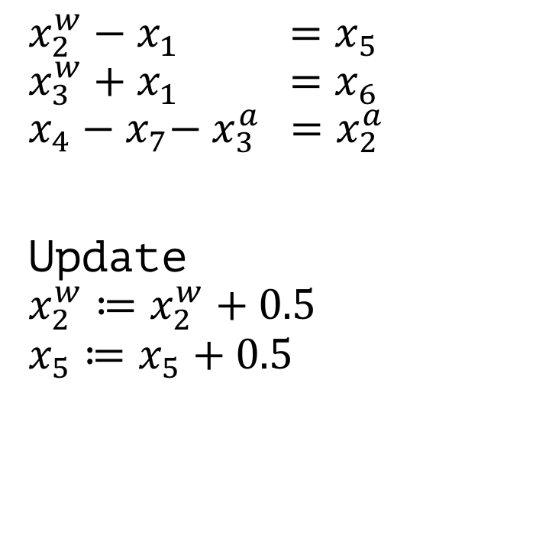
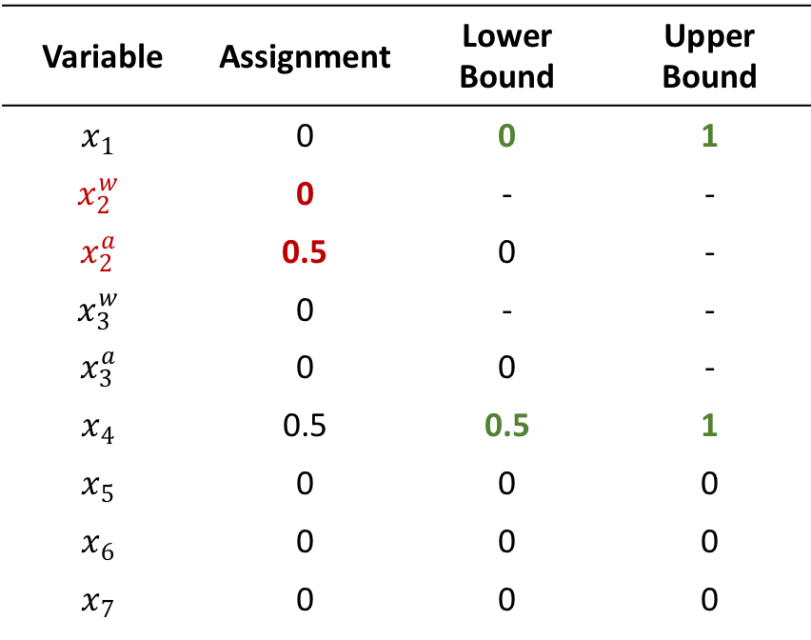
Example
Variable | Assignment | Lower Bound | Upper Bound
$$x_{1}$$ | 0 | 0 | 1
$$x_{2}^{w}$$ | 0 | - | -
$$x_{2}^{a}$$ | 0.5 | 0 | -
$$x_{3}^{w}$$ | 0 | - | -
$$x_{3}^{a}$$ | 0 | 0 | -
$$x_{4}$$ | 0.5 | 0.5 | 1
$$x_{5}$$ | 0 | 0 | 0
$$x_{6}$$ | 0 | 0 | 0
$$x_{7}$$ | 0 | 0 | 0
$$x_{2}^{w}−x_{1} =x_{5}$$
$$x_{3}^{w}+x_{1} =x_{6}$$
$$x_{4}−x_{7}−{ x}_{3}^{a} =x_{2}^{a}$$
Update $$x_{2}^{w}≔x_{2}^{w}+0.5$$
$$x_{5}≔x_{5}+0.5$$

Slide 29
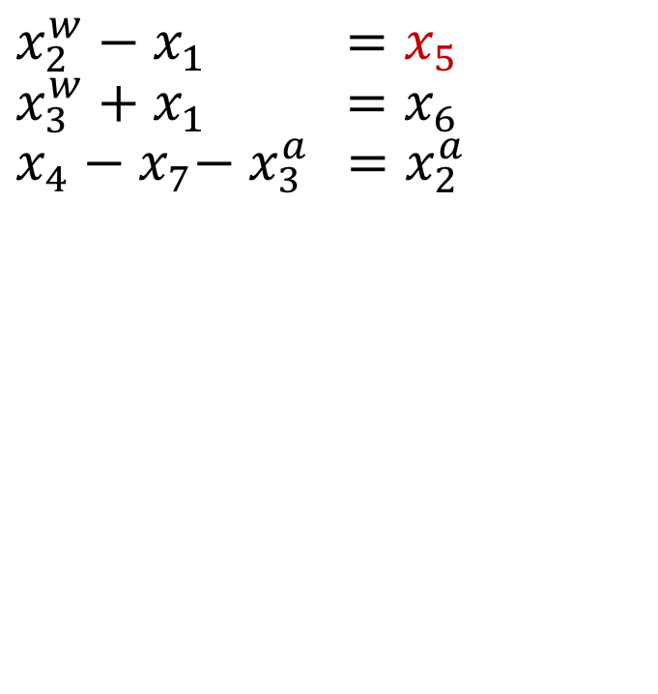
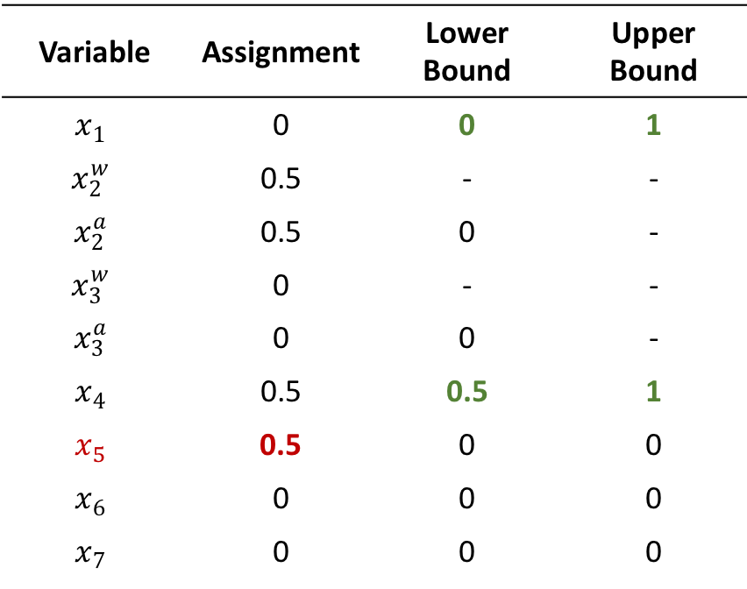
Example
Variable | Assignment | Lower Bound | Upper Bound
$$x_{1}$$ | 0 | 0 | 1
$$x_{2}^{w}$$ | 0.5 | - | -
$$x_{2}^{a}$$ | 0.5 | 0 | -
$$x_{3}^{w}$$ | 0 | - | -
$$x_{3}^{a}$$ | 0 | 0 | -
$$x_{4}$$ | 0.5 | 0.5 | 1
$$x_{5}$$ | 0.5 | 0 | 0
$$x_{6}$$ | 0 | 0 | 0
$$x_{7}$$ | 0 | 0 | 0
$$x_{2}^{w}−x_{1} =x_{5}$$
$$x_{3}^{w}+x_{1} =x_{6}$$
$$x_{4}−x_{7}−{ x}_{3}^{a} =x_{2}^{a}$$

Slide 31
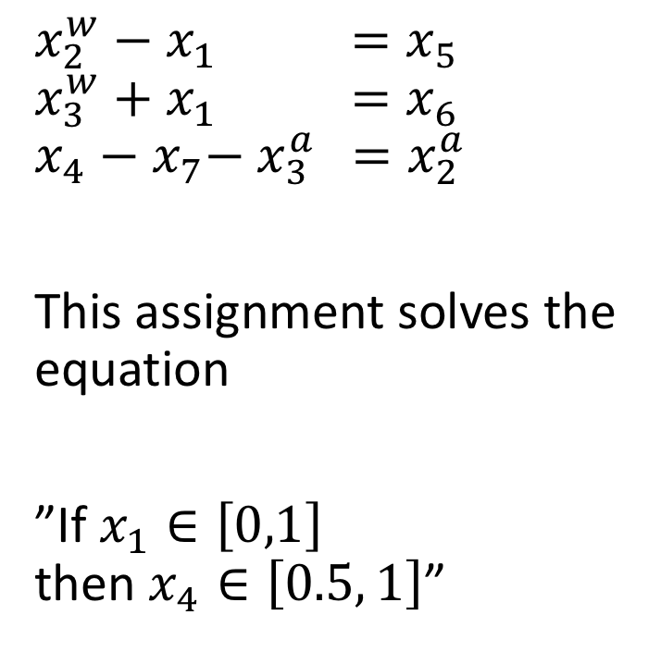
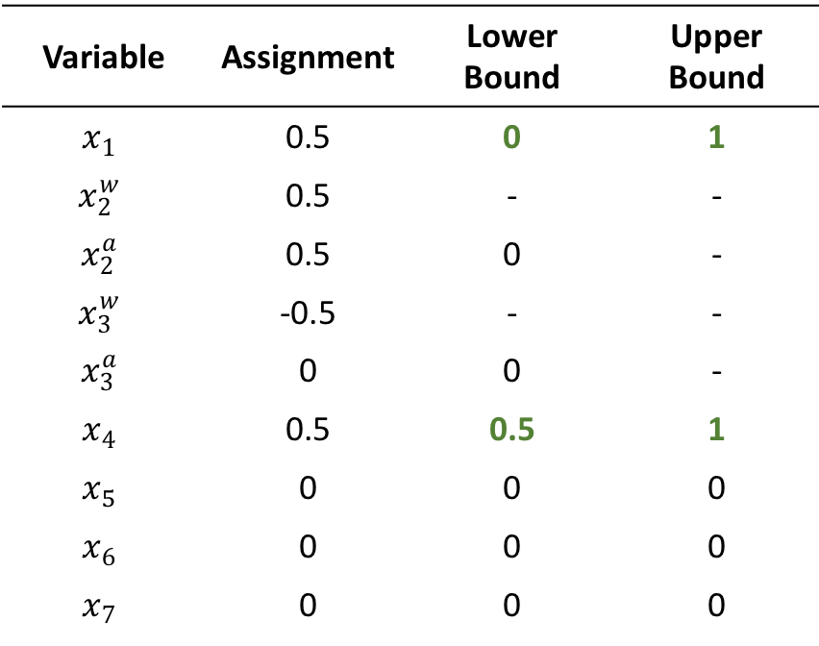
Result
Variable | Assignment | Lower Bound | Upper Bound
$$x_{1}$$ | 0.5 | 0 | 1
$$x_{2}^{w}$$ | 0.5 | - | -
$$x_{2}^{a}$$ | 0.5 | 0 | -
$$x_{3}^{w}$$ | -0.5 | - | -
$$x_{3}^{a}$$ | 0 | 0 | -
$$x_{4}$$ | 0.5 | 0.5 | 1
$$x_{5}$$ | 0 | 0 | 0
$$x_{6}$$ | 0 | 0 | 0
$$x_{7}$$ | 0 | 0 | 0
$$x_{2}^{w}−x_{1} =x_{5}$$
$$x_{3}^{w}+x_{1} =x_{6}$$
$$x_{4}−x_{7}−{ x}_{3}^{a} =x_{2}^{a}$$
This assignment solves the equation
”If $x_{1}∈\left[0,1\right]$ then $x_{4}∈\left[0.5, 1\right]$”

Slide 32
//Problems
Infinite Loop → Case Splitting
Implementation
How to define neighborhood of an image?
Noise?
Missing data?
What about other activation functions?
Needs to be linear
Approximation

Slide 33
//describe RELUPLEX …
Simplex Operations
Pivot_1
Pivot_2
Update
Failure
Success
RELUPLEX
Update_b
Update_f
PivotForRelu
ReluSplit
ReluSuccess
Optimization
deriveLowerBound
deriveUpperBound

Slide 34
Algorithm properties
Theorem on Q-Learning that converges

Slide 35

A Comprehensive Survey on Safe Reinforcement Learning (≤ 2015)
…

Slide 36
Lyapunov Functions

Slide 37

Lyapunov Design for Safe Reinforcement Learning (2002)
Optimal Control Problems
Works with any RL Algorithm
Idea: For a given problem, define actions that ensure any action will keep agent in safe state and moves it eventually there
Use RL to find a good combination of these actions
Problem: You need to come up with these actions by yourself

Slide 38

Safe Model-based Reinforcement Learning with Stability Guarantees (2017)
Main Idea: Be able to recover from every situation: “Asymptotic Stability”
Start with an initial, safe policy
Compute “region of attraction” via Lyapunov functions
Exploration will increase safe region and region of attraction
Specification: Policy will stabilize over time

Slide 39
Region of attraction: any set within this space will converge to a stable set/policy?
Starting from safe policy
Expand region of attraction by
Stability can be shown using Lyapunov functions

Slide 40
Car example: on the road
Given policy pi allpy dynamics f, function maps it to strictly smaller values
1. compute region of attraction for fixed policy
2. optimize policy to expand region of attraction

Slide 41

Region of Attraction

Slide 42
Problems
Safety in terms of probability. Probabilities can fail
Example: 99.999% it works, there are 1 000 000 drivers → it won’t stay safe for 10 drivers

Slide 43


Algorithm
1. SafeLyapunovLearning($π_{0}$, $𝒢𝒫\left(μ\left(z\right), k\left(z,z^{′}\right)\right)$) {
2. for n=1 to $∞$ {
3. Compute $π_{n}$ via SGD on (7)
4. $c_{n}={argmax}_{c} c :∀x∈𝒱\left(c_{n}\right)∩𝒳_{τ} :u_{n}\left(x, π_{n}\left(x\right)\right)−v\left(x\right)<−Lτ$
5. $S_{n}=\left\{\left(x,u\right)∈𝒱\left(c_{n}\right) × 𝒰_{τ} :u_{n}\left(x, u\right)≤c_{n}\right\}$
6. Select ${(x}_{n}, u_{n})$ within $S_{n}$ using (6) and drive system there with backup policy $π_{n}$
7. Update GP with measurements $f\left(x_{n},u_{n}\right)+ε_{n}$
8. }
9. }

Slide 44

Safe Reinforcement Learning via Formal Methods (2018)
Idea: Optimize a safe controller using RL
Explore through safe actions only
Use RL to solve optimization problem
Requirement
Controller that performs provable safe actions
(Physical) model of the reality

Slide 45

Differential Dynamic Logic $dℒ$
Hybrid program
precondition
postcondition

Slide 46



Hybrid Program $α$
Repeat arbitrary times
Controller
Either accelerate with $A$ or break
Model differential equations describe behavior
Either choose $a≔A$ or $a≔0$

Slide 47

Offline Verification
Verify offline that hybrid program $α$ performs safe actions

Slide 48

Full specification $dℒ$ formula
If our car moves forward with non-negative velocity
after choosing actions, it still has a non-negative velocity

Slide 49

Formula Transformations
Controller Monitor
What are our safe actions?
$$dℒ$$
ModelPlex
Model Monitor
Does our Model comply with the reality?

Slide 50


Controller Monitor $CM$
Input: Current State $s$, Action $a$
Output: True / False
Task: Check if performing action $a$ in state $s$ is safe according to our hybrid program $α$.

Slide 51

Controller Monitor Example
performing act() will not change path or velocity
ModelPlex
$$v_{\text{post}}=\text{act}\left(v_{\text{pre}}\right)$$
v_curr
p_curr
a_curr
act()
v_post = act(v_curr); p_post = act(p_curr); a_post = act(a_curr)
return (v_post == v AND p_post == p AND a_post == A) OR (v_post == v AND p_post == p AND a_post == 0);
True
False

Slide 52

Controller Monitor
KeYmaera X Theorem Solver
v_post = act(v_curr); p_post = act(p_curr); a_post = act(a_curr)
return (v_post == v AND p_post == p AND a_post == A) OR (v_post == v AND p_post == p AND a_post == 0);
Check if post-state can be reached by pre-state
$$v_{\text{post}}=\text{act}\left(v_{\text{pre}}\right)$$

Slide 53







Model Monitor
Is our Model accurate? Can our new state be explained by the model?
Model Monitor $MM:S × A × S→\left\{\text{True}\text{, }\text{False}\right\}$
Action 1: $a≔A$
Action 2: $a≔0$
$$v_{\text{pre}}$$
$$v_{\text{post}}=\text{act}\left(v_{\text{pre}}\right)$$
(expected by the model)
$$v_{\text{real}}$$
(observed)

Slide 54


Model Monitor $MM$
Input: previous state $s$, current state $\tilde{s}$
Output: True / False
Task: Is there a transition from the previous state $s$ to the current state $\tilde{s}$ that can be explained by the model?

Slide 55
Controller Monitor Example
ModelPlex
return t_post >= 0 AND
a_post == A AND
v_post == A*t_post + v_prev AND
p_post == A*t_post^2 / 2 + v_prev*t_post + p_pre) OR
t_post >= 0 AND
a_post == 0 AND
v_post == v_pre AND
p_post == v_pos*t_post + p_pre

Slide 56
Algorithm
1. JSCGeneric(init, (S,A,R,E), choose, update, done, CM, MM) {
2. prev := curr := init;
3. a0 := NOP;
4. while (!done(curr)) {
5. if (MM(prev, a0, curr)) {
6. u := choose({a ∈ A | CM(a, curr)});
7. } else {
8. u := choose(A);
9. }
10. prev := curr;
11. curr := E(u, prev);
12. update(prev, u, curr);
13. }
14. }
// or do something more clever (ask expert, …)

Slide 57

ModelPlex
Input: verified $dℒ$ formula $φ→\left[α^{∗}\right]ψ$
Output: (simpler) arithmetic formula
Task: Rewrite $dℒ$ formula Apply Theorem Proving until nothing can be done anymore

Slide 58


ModelPlex
Calculation Rules
Automatic Reasoning

Slide 59
Model might not reflect reality due to
Sensor errors
Mechanics malfunctions
Wrong (too simple) assumptions which do not hold in real life

Slide 60

Applying Formal Methods to Reinforcement Learning (2018)
Learn from demonstrations
Problem 1: Agent may encounter unseen situations
Solution: Dataset-Aggregation
Problem 2: Generate “expert” trajectories automatically
Solution: Reward function synthesis using formal methods.

Slide 61
//Proposed Method
Name some ideas?
Advantages and disadvantages
Boost safe method with formal verification
Show that a certain approach does not work
...

Slide 62
//Formal Verification – The solution?
Conclusion, Research Direction, ...
Short discussion on the research questions
Why formal verification does not make driving 100% save

Slide 63
//General Problems
Domain knowledge might be wrong
Model might not reflect reality
Constraints are hard to come up with
Probabilities
numeric errors → Verification of the implementation
Assumptions might be violated (or not considered!)
Continuity of dynamics, i.i.d., …
Formal Verification of “pure” program code is not possible (undecidable)

Slide 64
Open Questions and Problems

